Slide 1



REASE
A regional network to raise awareness on ecosystem services provided by seagrass meadows in the Algarve (south Portugal)
Rui Santos
Carmen B. de los Santos, Márcio Martins, Cátia Freitas, André Pinheiro, Cristina Veiga-Pires, Emanuel Reis, Rita Borges, Ana Ramos, Manuel Nora, José R. Cunha, Celeste Sousa and Helena Barracosa

Slide 2
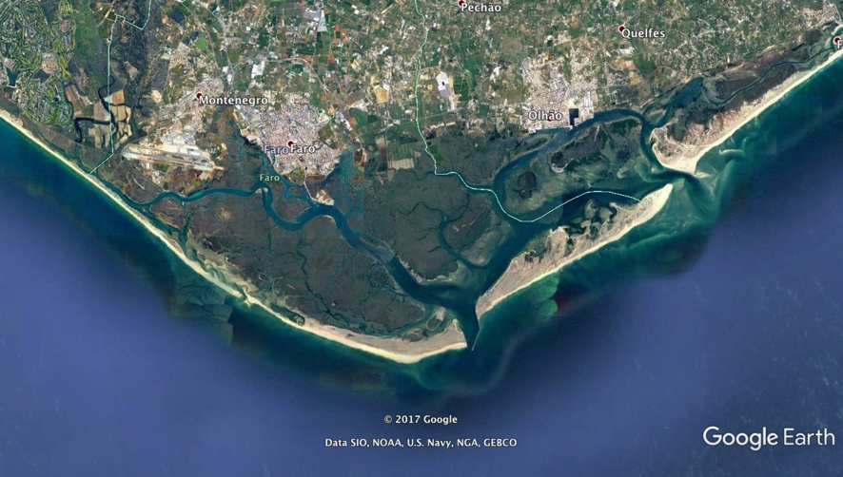
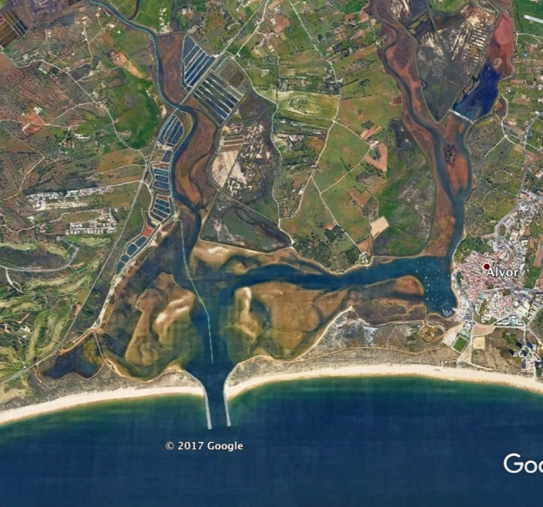
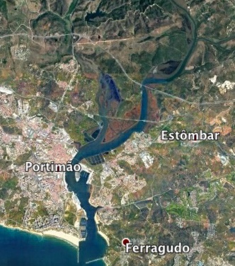
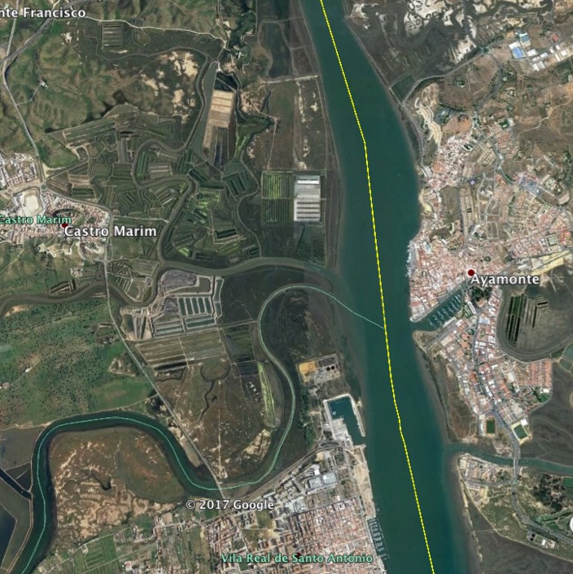

Slide 3
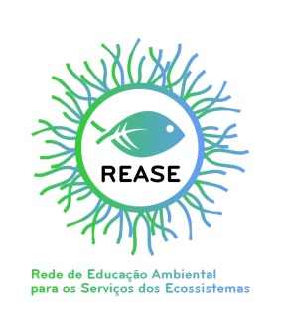
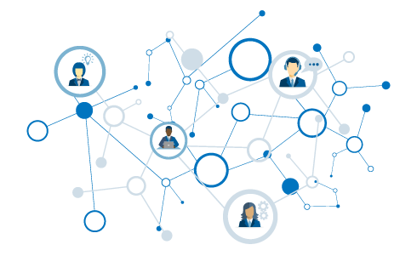
REASE
Environmental Education Network
for Ecosystem Services
REASE is a network of institutions of scientific research, education, science outreach and environmental NGOs of Algarve (south Portugal).
REASE aims to develop environmental education projects in the area of ecosystem services (ES), especially those provided by coastal vegetated ecosystems, including saltmarshes and seagrasses.

Slide 4
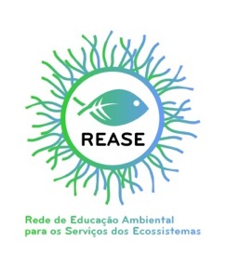
OBJECTIVES
Provide capacity building for school teachers and environmental managers in order to promote scientific knowledge on the services provided by coastal ecosystems
Develop an “Incubator of EE projects” to design innovative, formal education ES projects to be developed in local schools
To raise awareness of students and general public on the role of vegetated ecosystems for human well-being
Launch a Citizen Science project for schools to evaluate the Blue Carbon stocks of coastal ecosystems

Slide 5

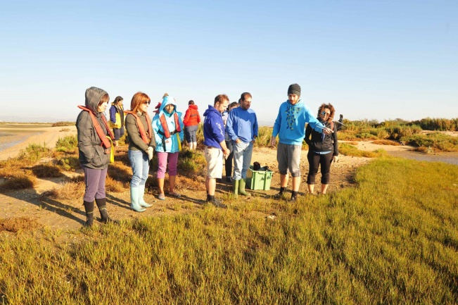
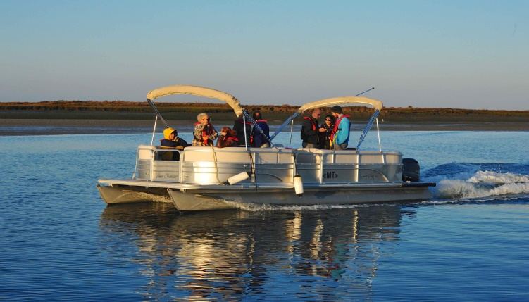
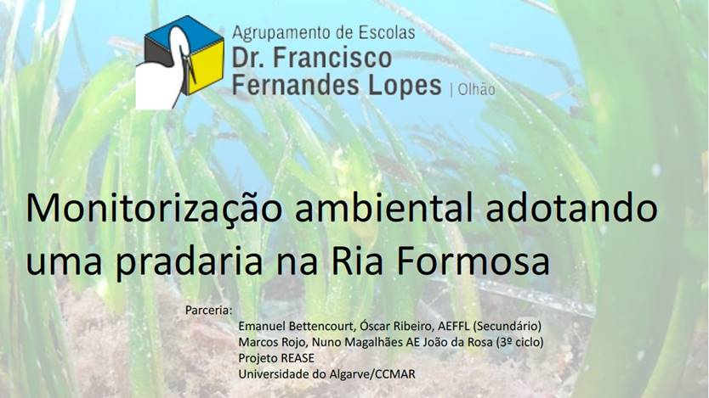
Capacity building
4 training courses on Ecosystem Services of coastal systems
60 teachers of several levels (K-12); 4 technicians of Environmental departments
Stakeholder workshops 12 eco-tourism enterprises

Slide 6
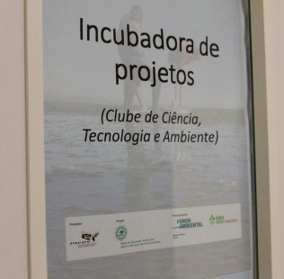
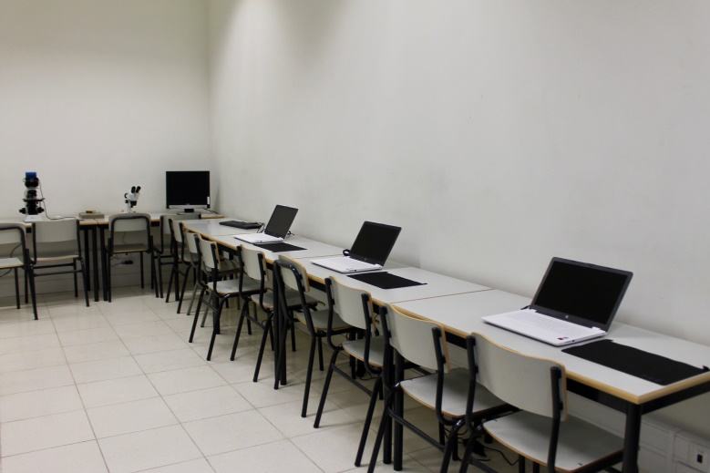
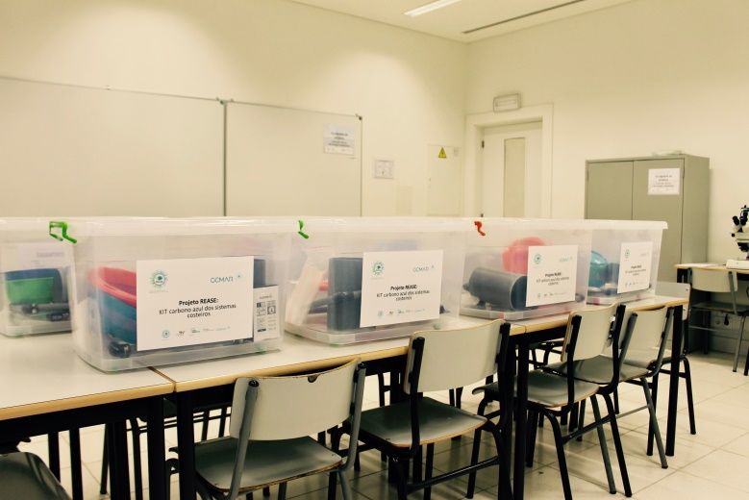
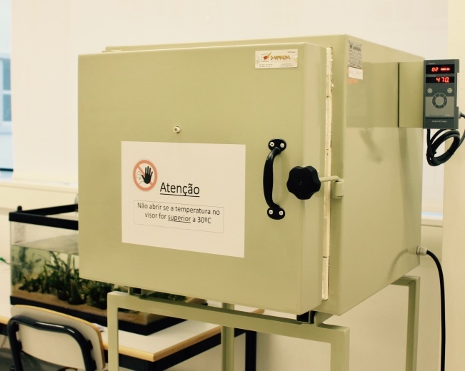
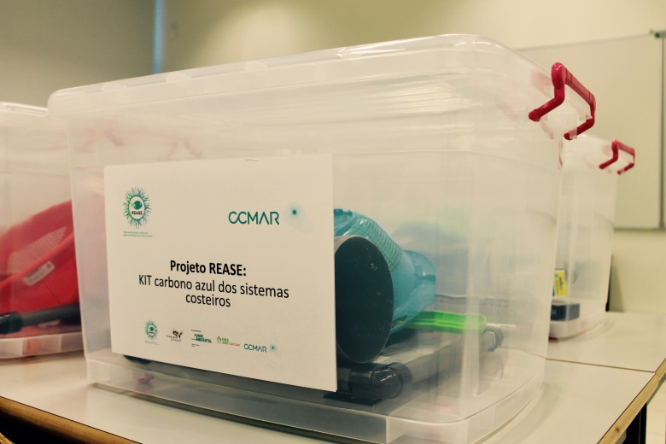
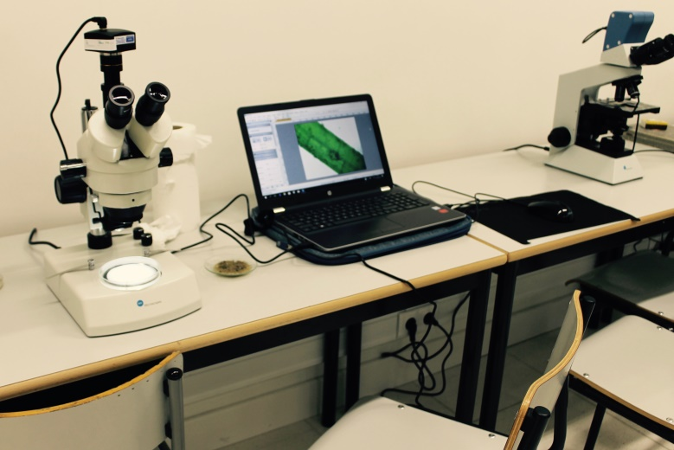
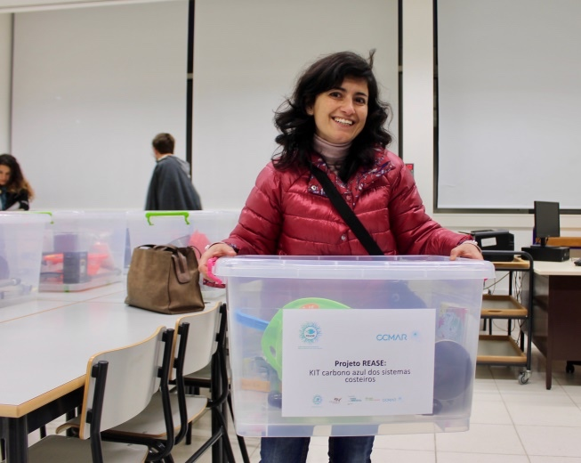
Incubator of ES projects (AEJD)

Slide 7
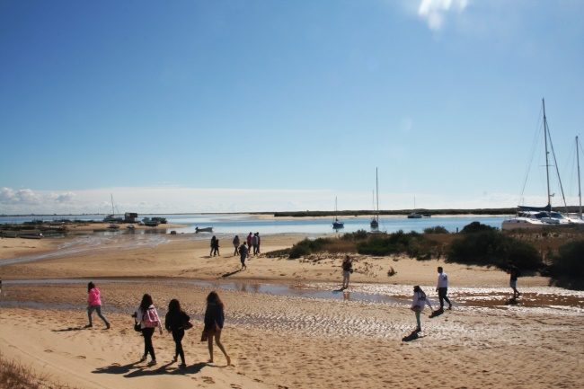
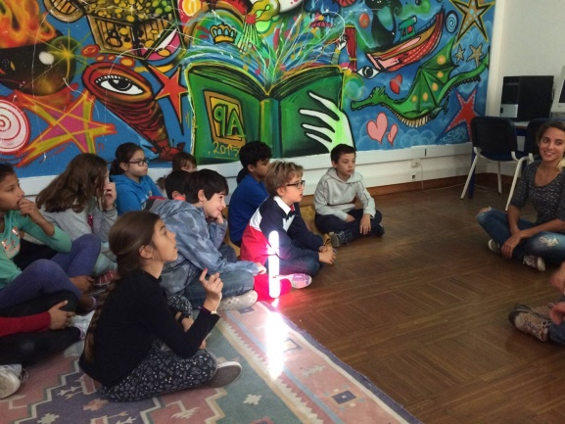
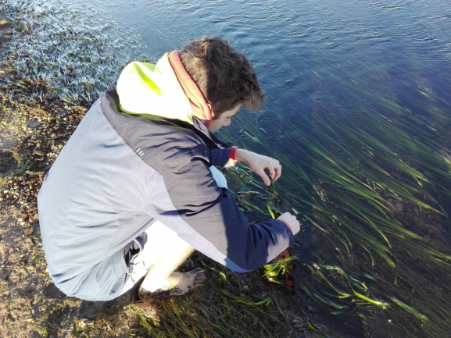
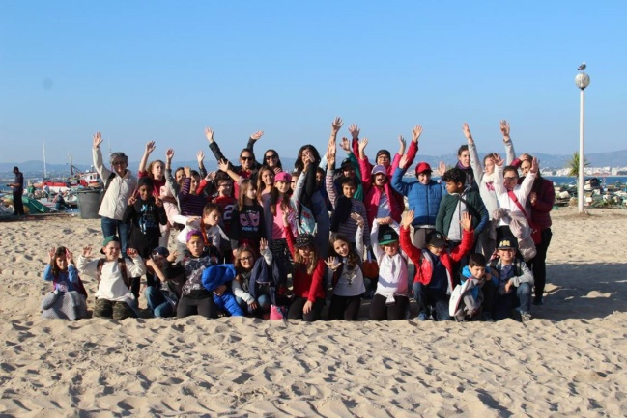
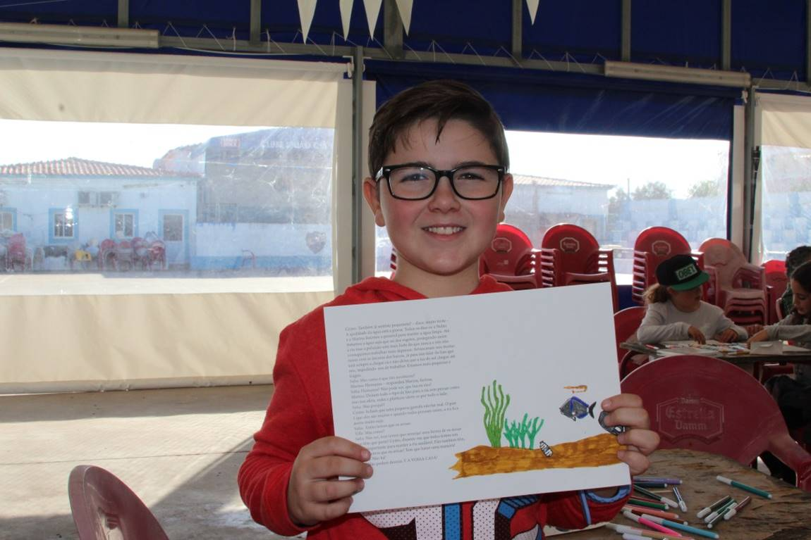
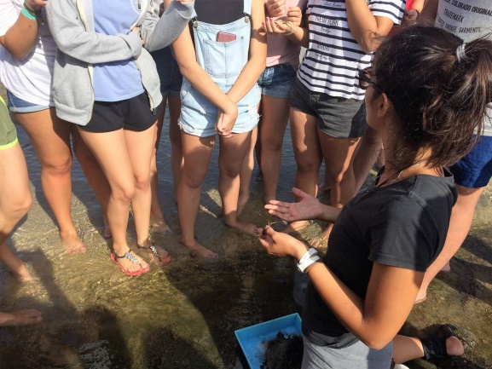
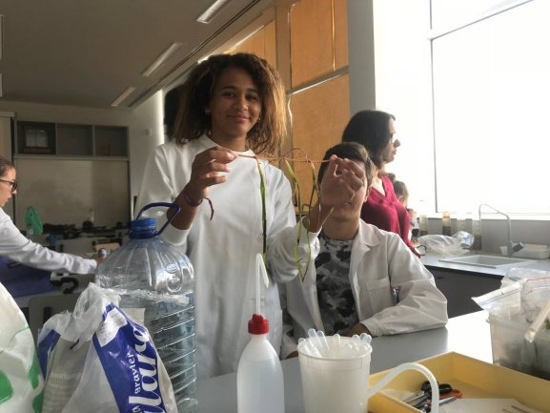
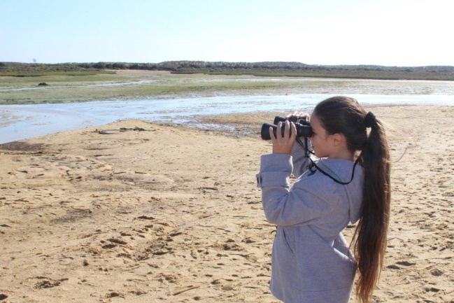
Incubator of projects
Develop school projects on coastal Ecosystem Services
> 500 children and 50 teachers are participating

Slide 8
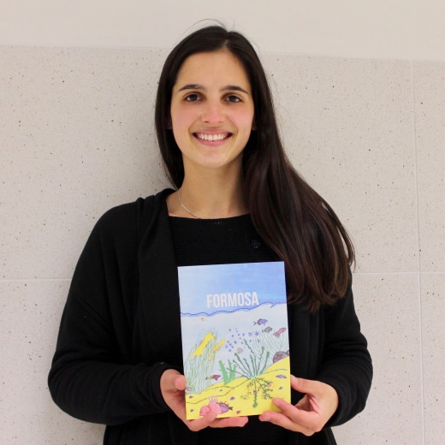

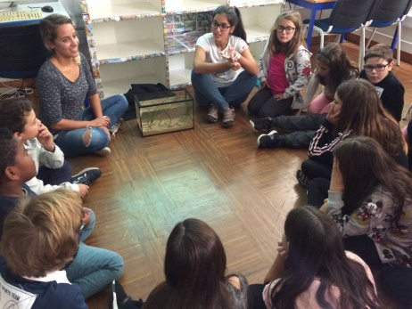
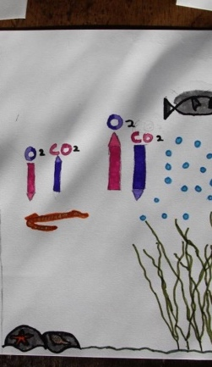
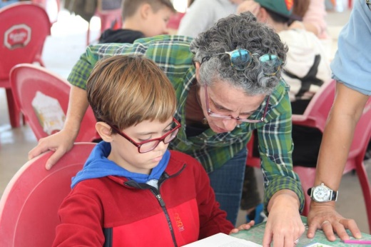
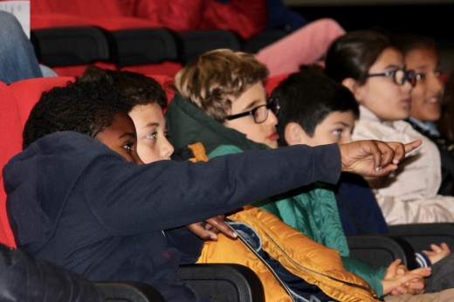
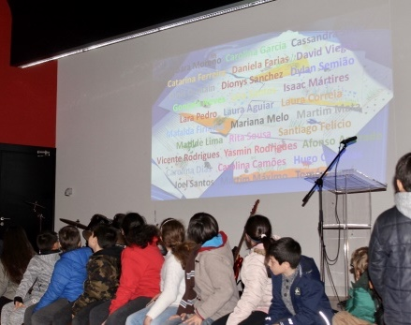
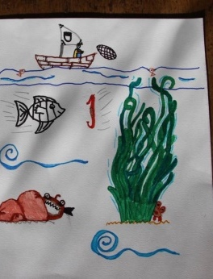
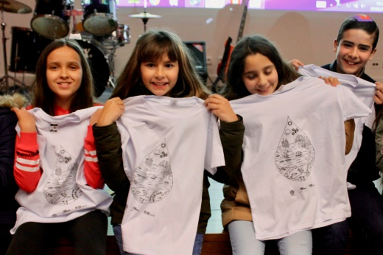
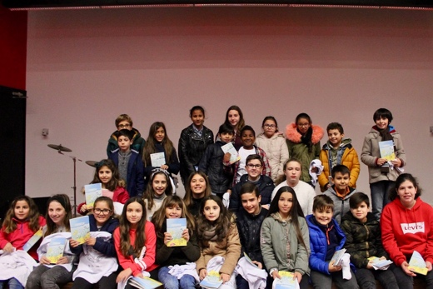
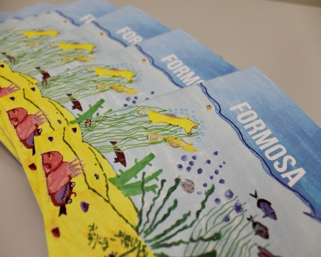
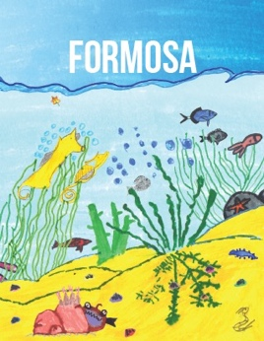
Booklet on the benefits provided by seagrasses

Slide 9
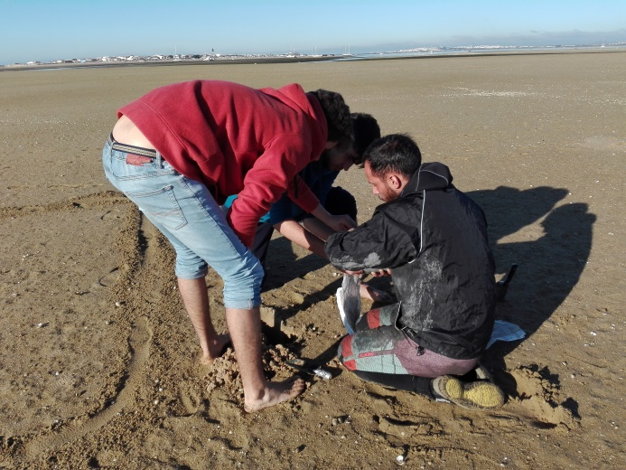

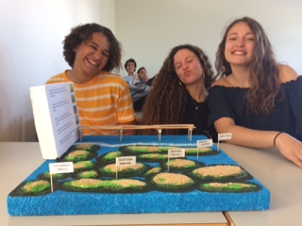
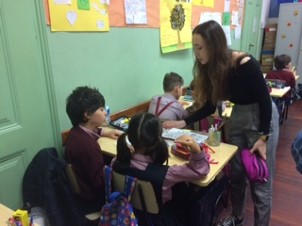
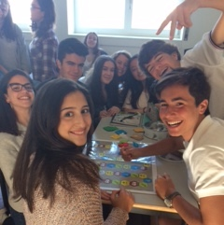
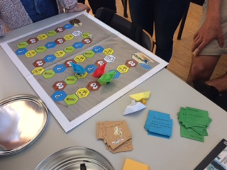
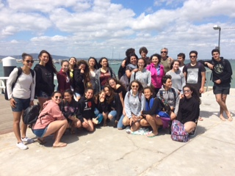
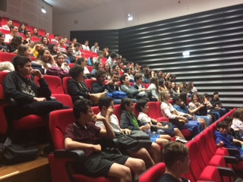
Incubator of ES projects

Slide 10
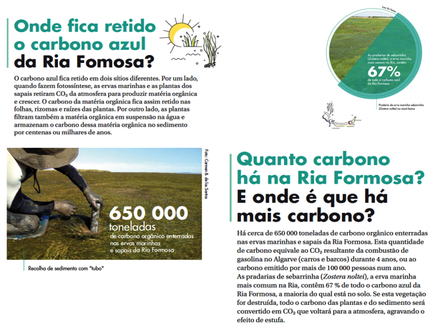
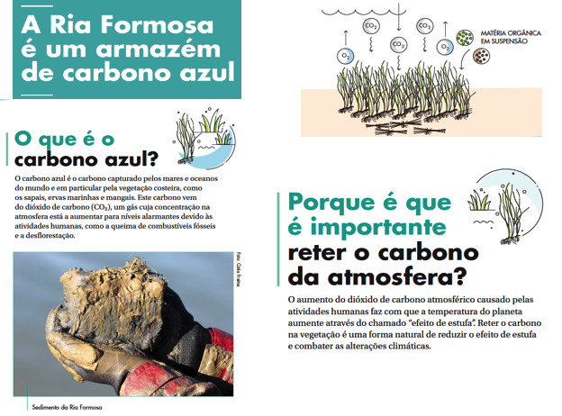
Awareness on the role of vegetated ecosystems for human well-being

Slide 11
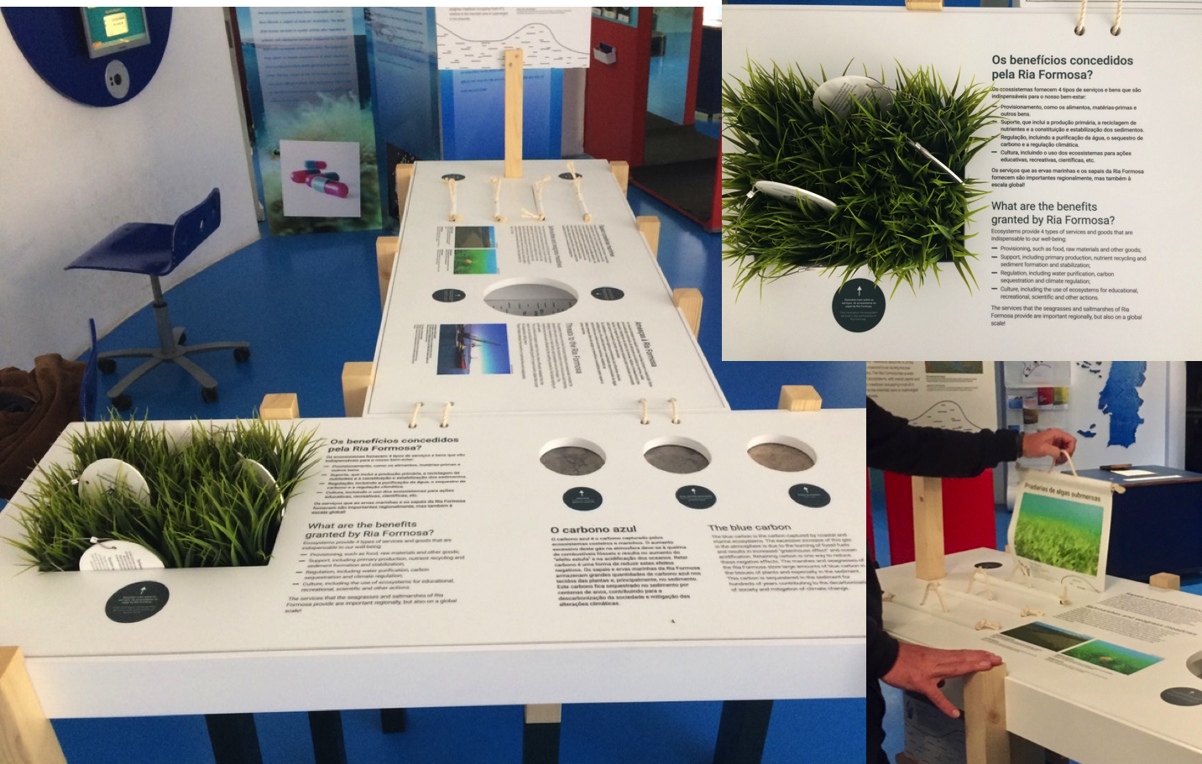
Awareness on the role of vegetated ecosystems for human well-being

Slide 12
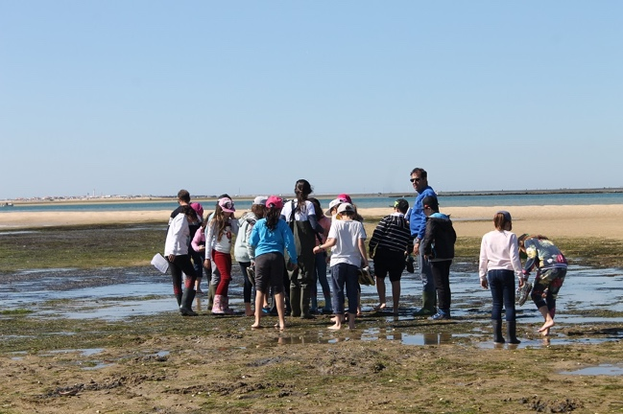
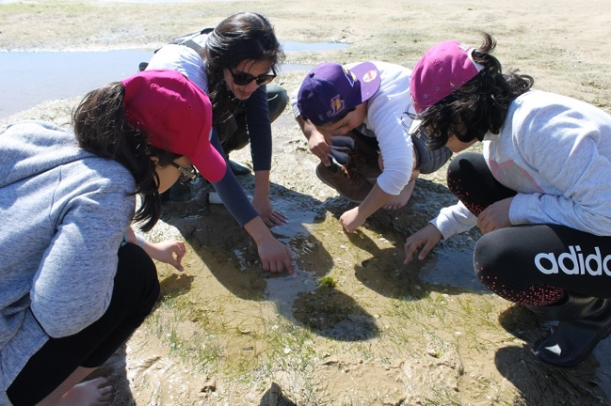
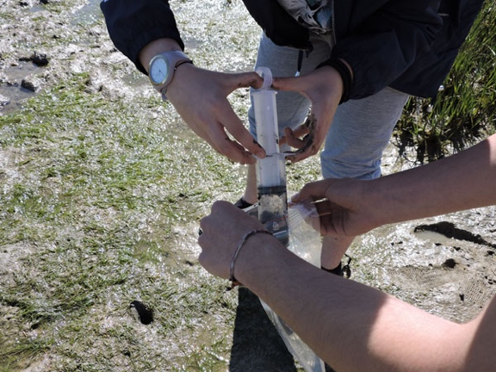
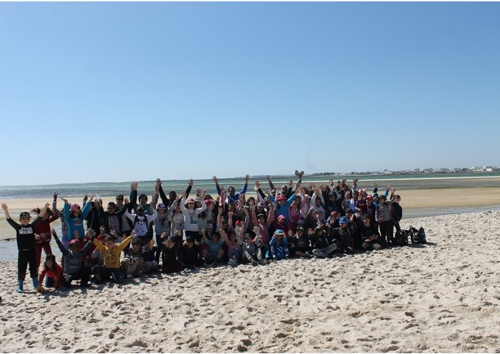




Citizen Science Blue Carbon Project

Slide 13





REASE App
Data are validated and analysed by researchers of CCMAR.

Slide 14


REASE website
http://rease.ccmar.ualg.pt/#home

Slide 15






Dissemination (Media)

Slide 16

Thank You !

