Slide 1


Agrupamento Vertical de Almancil
Escola E. B. 2, 3 Dr. António de Sousa Agostinho
English - 8º E
1st session – 27/03/2014
Teacher Rita Pereira

Slide 2

Can you unscramble this sentence to find what we are going to talk about?
Activity 1

Slide 3
healthy.
smart,
Eat
stay
Yes, we can. The sentence is…

Slide 4
Eat smart, stay healthy.
It means that…
a) … you should not be careful with what you eat to have a healthy life.
b) … you should pay attention to what you eat to have a healthy life.
What does this sentence mean?

Slide 5
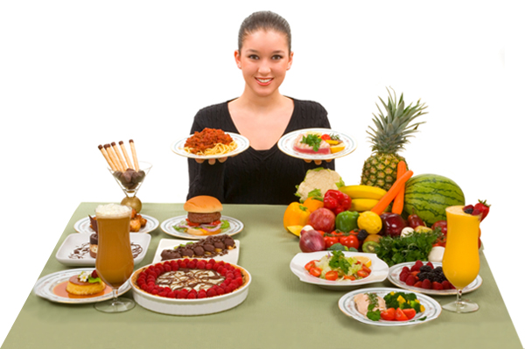

Healthy vs unhealthy food

Slide 6
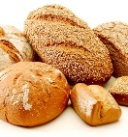
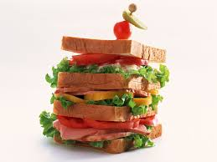
Food
Bread
Sandwich
Activity 4

Slide 7
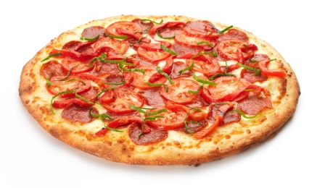
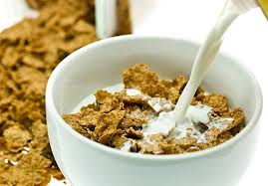
Pizza
Cereals

Slide 8
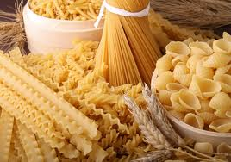
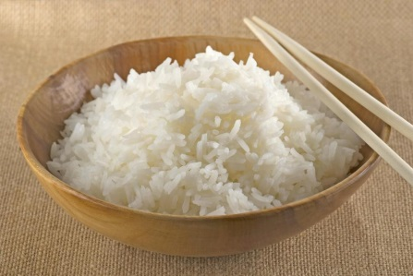
Pasta
Rice

Slide 9
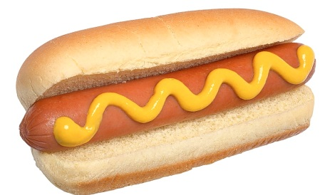
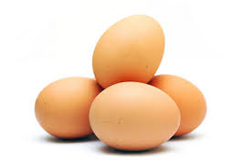
Hot dog
Eggs

Slide 10
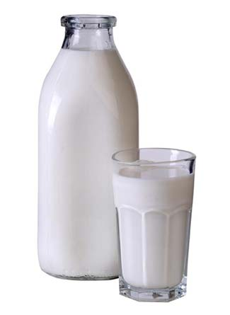
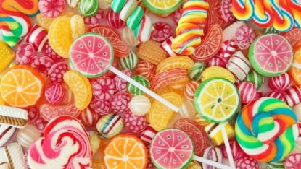
Sweets
Milk

Slide 11
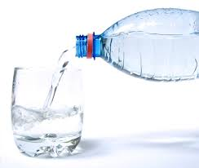
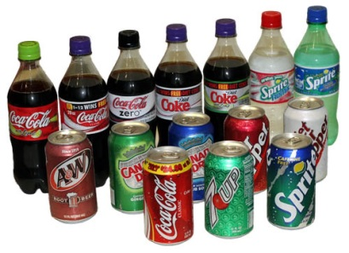
Water
Sugary Drinks

Slide 12
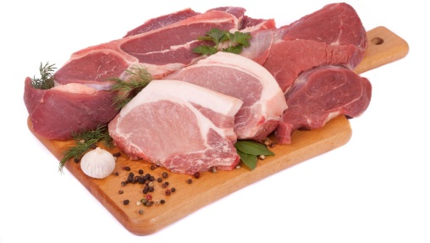
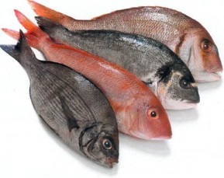
Meat
Fish

Slide 13
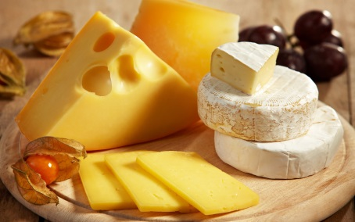
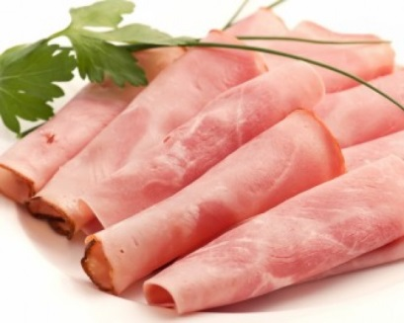
Ham
Cheese

Slide 14
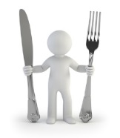





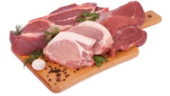
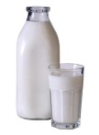

Healthy Food
Ham
Bread
Rice
Eggs
Fish
Cereals
Meat
Pasta
Water
Milk
Activity 5

Slide 15
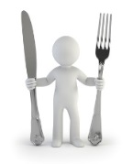



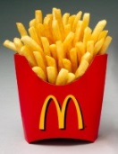
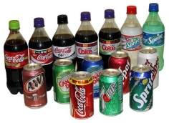


Unhealthy Food
Hamburger
Hot dog
French fries
Sugary drinks
Pizza
Sweets
We shouldn’t eat unhealthy food because it has too much salt, sugar and fat.
I mustn’t eat fast food. My doctor has forbidden me.
Sandwich

Slide 16
Modal Verbs
Should/Shouldn’t
Schools should ban unhealthy food machines and water machines should replace sugary drinks machines
Parents should educate their children to eat well.
We shouldn’t eat unhealthy food because it has too much salt, sugar and fat.
We must drink a lot of water every day.
Parents must also start cooking healthy meals at home instead of buying junk food at the nearest fast food restaurant.
Must
I mustn’t eat fast food. My doctor has forbidden me.
Mustn’t
Activity 6

Slide 17

MUST is used to express an ___________________________!
SHOULD and SHOULDN’T are used to give an _____________!
Obligation/strong recommendation
MUSTN’T is used to express a ______________!
advice
prohibition
Exercise 2

Slide 18

He loves apples. He should eat apples.
Modal verbs ___________an “s” on the third person singular – he/she/it.
don’t need
need/don’t need
We must drink a lot of water.
Modal verbs are always followed by a _______ in the infinitive without “to”.
verb
noun/verb
Modal verbs are very special verbs. Can you help me complete these sentences to learn how they are used?

Slide 19
He doesn’t like apples. He shouldn’t eat sweets.
They don’t like apples. They shouldn’t eat sweets.
Do we like apples? Yes, we do. Should we eat sweets? No, we shouldn’t.
In the negative and interrogative form, modal verbs ______________ the auxiliary verb “to do”
don’t need
need/don’t need
Modal verbs are very special verbs. Can you help me complete these sentences to learn how they are used?

Slide 20
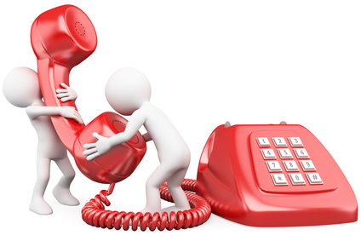
a)
Listener: What should I do to lose some weight?
Doctor Pam: You should/mustn’t avoid sweets and fast food. You must/shouldn’t drink a lot of water. You should/mustn’t drink sugary drinks. You should/mustn’t also do some exercise.
b) Listener: My children love chocolates. They are always eating them. What should I do?
Doctor Pam: First, you shouldn’t/should have chocolates at home. If you don’t have chocolates, your children will not eat them. Then, you must/mustn’t tell your children that chocolates are unhealthy. You should/mustn’t always have fruit at home because fruit is also sweet but it is healthy. We should/mustn’t prefer fruit to sweets.
Exercise 3

Slide 21
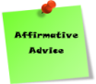


The modal verbs’ loop game
FINISH: answer
answer
answer
START: question
question
question
Should
answer
answer
question
question
answer
answer
answer
Shouldn’t
question
question
question
Activity 7
Must
Mustn’t

